Slide 1
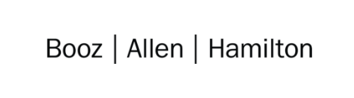

Cloud Excellence Presentation
Team 5 "The Fantastic 5"
Members: Jonathan Moriarty-AWS Admin David Michel-Safety Nathaniel Ouzts-Speaker/Presenter Darrell Leeks-Safety Shekita Dyson-Scribe
October 27, 2021

Slide 2
Our Project
Introductions
Project Overview
Architecture/Design diagram
Tools/Software Environment used
Challenges/Issues/Problems/Your stories
What have you learned/learned?
What else can we do on the project? - future plan- any design and implementation ideas?
Demo
Questions and answers
A DevSecOps CI/CD Pipeline for deploying CloudFormation templates that integrates Bridgecrew to perform automated security checks to ensure the security of resources deployed to the cloud.
www.webagesolutions.com|1.877.517.6540

Slide 3






Nathaniel Ouzts Technologist
Jonathan Moriarty Staff Engineer
Shekita Dyson
Cloud Engineer
Darrell Leeks
Solutions Architect
David Michel Technologist
Notes:
TODO: Add team member photos

Slide 4
TEAM 5:
CI/CD pipeline for deploying an AWS CloudFormation stack from a template file hosted on a GitHub repository.
AWS CodeBuild integrates the third-party tool Bridgecrew, which performs automated security scans of our CloudFormation template file, generating reports.
The pipeline proceeds with the automated deployment of the CloudFormation stack if those security checks are passed.
The GitHub repo is integrated with Bridgecrew directly to generate pull requests to resolve detected security issues.
Our Official Project for the Booz Allen Cloud Excellence Program
www.webagesolutions.com|1.877.517.6540
Notes:
-The CI/CD pipeline is build with AWS CodePipeline.
-The pipeline starts automatically when changed code is pushed to the Git repo.

Slide 5
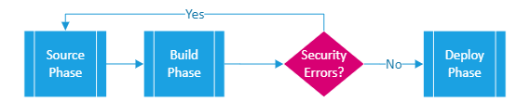
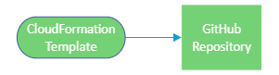
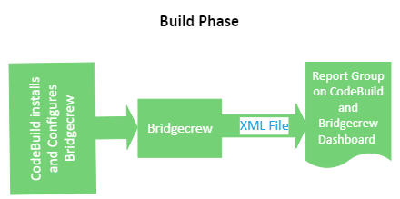
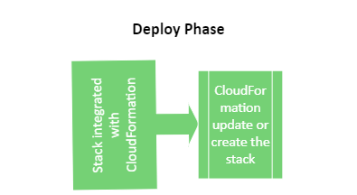
Architecture and Design
Source Phase
1. CloudFormation Template hosted in GitHub Git repository enters AWS CodePipeline "Source" phase when changes are detected.
2. CodePipeline passes the Template to the "Build" phase, which uses AWS CodeBuild.
3. CodeBuild installs and configures Bridgecrew (Checkov CLI) which perform a scan on the Template file for security errors.
4. All test results are dumped to an XML file and a Report Group on CodeBuild for further review. Results are also pushed to the Bridgecrew Dashboard.
5. If all security checks are passed (or the build is configured to proceed if some checks fail), CodePipeline proceeds to the "Deploy" phase.
6. The "Deploy" phase integrates with AWS CloudFormation to create or update the stack contained in the Template file.
7. (Optional) GitHub can be directly integrated with Bridgecrew to allow for generated Pull Requests to fix detected security issues.

Slide 6
Technologies and Environment used
Git with GitHub
AWS
Cloud9
EC2, EBS, CLI
CodePipeline
CodeBuild
CloudFormation
VPC, S3
IAM
Bridgecrew
Checkov CLI
YAML, JSON
Notes:
-EC2, EBS, and CLI are used through Cloud9. VPC and S3 are used through CloudFormation (they're part of the demo.yaml template in the repo).
-We also technically use a little bit of Python but not really directly, it's part if the installation process for Bridgecrew on the CodeBuild environment from the buildspec.yaml.
-JSON is used to get a description of the AWS CodePipeline and CodeBuild project (retrieved with the Amazon CLI using Cloud9 workspace). Can be used to recreate them with some modifications.
-*Technically* used AWS SSM to put the Bridgecrew API key for Bridgecrew integration into AWS so we could retreive and use it securely in CodeBuild.

Slide 7
Challenges and Issues
Discrepancies between the initial guide we were following and the current Bridgecrew integration process.
The buildspec YAML for CodeBuild was failing to execute.
Permission errors when implementing the CloudFormation Deploy phase.
Correcting issues with the buildspec for the Build phase introduced an error in our Deploy phase.
Updating to use a more complicated CloudFormation template generated new problems in the Deploy phase.
Notes:
1. Guide for Bridgecrew was slightly out-of-date, the name for the Bridgecrew API key AWS SSM parameter was different between the initial guide and the Dashboard integration process. The buildspec.yaml file generated by Bridgecrew had a minor syntax error that needed to be corrected (random inserted line with false on it).
2. The aws-code-extras script was trying to extract git metadata to use in parameters for commands (like the branch name), but the command was failing because no .git directory is included in the Source when it's grabbed as a zip, we had to go into cloud9 and repeat commands from the buildspec and shell script to determine this, the first fix was to hard code branch name in the buildspec, then to change the Source action to grab a full clone (which required changing the action settings and enabling more IAM permissions for the service role).
3. Had to figure out how best to deploy the specific demo YAML file to CloudFormation (looked at CLI or adding to the buildspec, but decided it was better to add the Deploy phase to AWS CodePipeline).
4. Had to add to trust relationships for pipeline service role to include trust of AWS CloudFormation (in addition to already trusted codepipeline).
5. Had to modify the demo yaml file to include an s3 bucket resource and change the names and defaults of some parameters in the demo YAML.
6. CodePipeline Deploy didn't like using the "Source" as an Input artifact because it was configured to do a full clone of the source repo. Solution was to add a 2nd "SourceZip" Action to the Source phase that grabbed the zip of the github repo, zip passed to deploy phase, full clone passed to build phase.
7. Needed to fix IAM permissions for deploying YAML files with ssm params for Deploy phase.
Bullet point 2: The buildspec YAML generated by Bridgecrew for CodeBuild was initially failing to execute. Viewing the build logs showed it was an issue with the "aws-code-extras" shell script that was being downloaded and run to fetch git metadata that the script was using for Bridgecrew commands.
Bullet point 3: Once we had the Source and Deploy phases working, we had to add and configure the Deploy phase to use CloudFormation. Troubleshooting this required modifying the trust relationship and IAM permissions for the service role for the pipeline.
Bullet point 4: After we had gotten a first working version, we went back to correct issues with the buildspec by modifying the Source Action to grab a full clone of the source code instead of a zip file, this introduced an error in our Deploy phase that we had to correct.
Bullet point 5: Our pipeline initially worked with an exceedingly simple CloudFormation template, but updating to a more complicated template generated problems that were solved with additional IAM permissions for the service role.
We have found a few discrepancies. The YAML that was generated by Bridgecrew for Code Build had failed to execute. Reviewing the logs showed the aws code extra shell script that was downloaded and run to fetch git meta data. Once we got everything working, we configure the deploy phase to use CloudFormation. After that was resolved, we went back to correct issues with the buildspec by modifying the source action to retrieve a full clone of the source code instead of a zip file that had caused it to fail initially. The pipeline worked with the simple CloudFormation template. We discovered that updating to a more complicated template caused problems that were solved with IAM permissions.

Slide 8
Lessons Learned
Starter CloudFormation templates are very useful for getting things launched quickly, but they don't often adhere to security best practices.
Bridgecrew has the potential to be a powerful tool for helping to automate DevSecOps.
AWS CodePipeline makes CI/CD pipelines easy to connect with other AWS services....BUT It's not Jenkins. AWS CodePipeline lacks the ability to directly export pipelines and build projects to formats that can be tracked in VCS.
Notes:
-Funny story about integrating Bridgecrew into AWS CodePipeline, the process had actually slightly changed additionally between when we set up the first test version of the project vs. when we set up the second cleaner version of the pipeline.
-Explain that you can use the AWS CLI to grab JSON descriptions of resources like pipelines and build projects that can be turned into templates, but it requires some manual configuration and modification of those exports to do so.

Slide 9
Future Goals
Add an additional Source Action to the pipeline that updates the Buildspec YAML in the CodeBuild project to the latest version from the Git repo.
Support more granular testing with Bridgecrew like skipping specific checks, or only performing certain checks.
Add AWS SNS to notify specific team members when their commit creates a security issue.
Add a manual approval stage after Bridgecrew scan to allow developers to review the results of the Bridgecrew scan and proceed to deploy potentially unsecure resources at their discretion.
Notes:
Example: An S3 bucket for website hosting will always have be flagged for *some* security issues because of it having to be publicly acceptable, so developers should be able to tell Bridgecrew to ignore certain checks for specific resources, and additionally have the option to deploy resources after reviewing results of security testing if the issues discovered are not considered to be a concern.
-Bridgecrew / Checkov CLI supports this granular testing, but it is not currently integrated into the pipeline (would have to be included in the buildspec for the CodeBuild project).

Slide 10
Demo

Slide 11

Q & A - Ask us anything

Slide 12
Thank you!!!
October 2021

